Slide 1

Department of Computer Science and Engineering
(Cyber Security)
CS23533– Foundations of Artificial Intelligence
2026-2027
HireAI: A Rule-Based Intelligent Recruitment Expert System
✦ Pure Classical AI Architecture | Deterministic Forward Chaining | Zero Black-Box Bias ✦
Supervisor:
Dr. S. Bhuvana, Ph.D.
Assistant Professor (SG) | CSE (Cyber Security)
Presented By:
241901067 – NAVANEETHA KRISHNAN E
241901114 – SURVESVARA KUMAR J S
Notes:
Good morning respected evaluators. Today we present HireAI, a pure Classical Artificial Intelligence expert system for auditable recruitment.

Slide 2
Problem Statement and Motivation
❌ THE TALENT ACQUISITION CRISIS (PROBLEM)
Screening Fatigue: Recruiters evaluate 250+ resumes per job post, spending 6-8 seconds per document; subjective manual review leads to 40%+ inconsistent false negatives.
Black-Box ML Opacity: Deep learning and vector ATS hide evaluation criteria in latent spaces; zero inspectable proof traces leave candidates and recruiters without justifications.
Systemic Demographic Bias: Probabilistic models trained on legacy hiring data replicate and amplify historical gender, racial, and institutional disparities.
Prompt Injection Vulnerability: LLM parsers are easily compromised by prompt overrides and white-text keyword stuffing embedded in candidate PDFs.
PII Exposure Risks: Traditional platforms write resumes to unencrypted server disks, violating strict data privacy laws (GDPR & ISO/IEC 27001).
Notes:
Slide 2 defines the crisis: modern recruitment receives 250+ resumes per job. Existing ATS rely on black-box embeddings or LLMs that hallucinate and leak PII. HireAI uses classical first-order logic.

Slide 3
Problem Statement and Motivation (cont.)
🛡️ MOTIVATION & HIREAI PARADIGM (SOLUTION)
EU AI Act & Global Mandates: Regulation 2024/1689 designates automated recruitment as 'High-Risk AI', legally mandating auditability and bias prevention.
Pure Classical First-Order Logic: Replaces stochastic embeddings with deterministic IF-THEN Horn clause production rules operating over explicit candidate facts.
100% Explainable Proof Traces: Produces granular audit logs detailing exact matched skills, missing criteria, and experience margins for every evaluation.
Zero Demographic Bias: Evaluates strictly on verified credentials, eliminating name, gender, age, and college proxies from decision paths.
Sub-50ms CPU Execution: Processes resumes in volatile RAM (io.BytesIO) in under 42ms with zero cloud GPU cost and zero LLM API dependency.

Slide 4
Project Objectives
01 – Design Knowledge-Based Expert System [Unit IV: Knowledge-Based AI]
Develop HireAI as an automated, objective screening system replacing subjective human review with deterministic First-Order Logic rules.
02 – Engineer Forward-Chaining Rule Engine [Unit IV: Inference & Deduction]
Implement production rules over candidate facts and job criteria to validate minimum experience, degree tiers, and mandatory skills.
03 – Formulate Multi-Criteria Heuristic Scorer [Unit II & III: Heuristics & CSP]
Calculate a composite candidate rank score balancing Skills (50%), Experience (25%), Education (15%), and Certifications (10%) with domain misalignment penalties.
Notes:
Slide 3 presents our 5 core objectives, each grounded in the Foundations of AI syllabus.

Slide 5
Project Objectives (cont.)
04 – Build Explainable Decision Support (XAI) [Explainable AI]
Synthesize human-readable proof traces itemizing matched competencies, missing criteria, and score derivations for every applicant.
05 – Deploy Full-Stack Dual Portals & Enterprise Kanban [System Architecture]
Deliver an asynchronous FastAPI REST microservice paired with dedicated React 18 SPAs for Candidates and HR Recruiters featuring synchronized hiring pipelines.

Slide 6
Project Abstract
EXECUTIVE SUMMARY & CLASSICAL AI CORE
Domain & Scope: HireAI is an enterprise-grade AI-Based Recruitment System designed to automate resume screening, candidate ranking, and hiring pipeline synchronization.
Deterministic AI Architecture: Unlike probabilistic ATS systems relying on opaque neural embeddings or LLMs, HireAI implements pure Classical AI: First-Order Logic production rules, domain ontologies, and deterministic forward chaining.
Zero-Disk Volatile Processing: Ingests binary PDF/DOCX resume streams strictly in RAM byte buffers (io.BytesIO), performing line-by-line AST sanitization and word-boundary tokenization without persisting unencrypted candidate PII to disk.
Explainable Decision Support: Evaluates candidate facts against recruiter job criteria across 4 dimensions: Technical Skills (50%), Experience (25%), Education (15%), and Certifications (10%).
Notes:
Slide 4 summarizes the project abstract, covering both the theoretical AI foundation and full-stack software implementation.

Slide 7
Project Abstract (cont.)
FULL-STACK PLATFORM & EMPIRICAL EVIDENCE
Dual Role-Based SPAs: Independent React 18 Single-Page Applications: Candidate Portal (Port 5173) for resume audit and gap advice; HR Recruiter Dashboard (Port 5174) for requisition creation, ranking, and Kanban management.
5-Pillar ATS Health Auditor: Audits resumes across Format & Parsability (20%), Keyword Density (25%), Measurable Impact (20%), Section Completeness (20%), and Contact Hygiene (15%).
Strict Enterprise Security: Stateless JWT authentication (HMAC-SHA256), BCrypt password hashing, Supabase PostgreSQL Row-Level Security, and isolated physical company vaults.
Benchmarked Performance: Verified across 1,000 evaluations: 38.4ms average latency, fully deterministic scoring, 4.2 MB RAM usage, and 40/40 passing pytest test cases.

Slide 8
Literature Survey – Part 1
S. No. | Author(s) & Year | Paper Title | Methodology / Algorithm | Limitations Identified
1 | Faliagka et al. (2012) | Application of machine learning algorithms to an online recruitment system | Supervised ML & linguistic NLP ranking on public candidate profiles & LinkedIn metadata | Lacks explainable rule auditability; high susceptibility to social profile noise, unverified claims, and demographic bias.
2 | Roy et al. (2020) | A Machine Learning approach for automation of Resume Recommendation System | Deep Learning semantic similarity using BERT embeddings & dense vector cosine distance | Opaque 'black-box' latent space fails explainability; high cloud GPU compute overhead, token latency, and non-deterministic scoring.
3 | Al-Mansoor et al. (2021) | Neural ATS with transformer-based extraction | Multi-task Transformer models for unstructured resume entity parsing and classification | Prone to generative hallucination of non-existent skills; vulnerable to prompt injection and historical demographic bias.
Notes:
Slide 5 covers the first three seminal papers showing how statistical and deep learning screeners lack explainability.

Slide 9
Literature Survey – Part 2
S. No. | Author(s) & Year | Paper Title | Methodology / Algorithm | Limitations / Regulatory Relevance
4 | Russell & Norvig (2020) | Artificial Intelligence: A Modern Approach (4th ed.) | Classical Rule-Based Expert Systems, First-Order Horn Clauses & Forward Chaining | Guarantees logical deduction, deterministic consistency, and proof trees. Requires curated domain ontologies (solved via HireAI's 40+ tech taxonomies).
5 | European Commission (2024) | EU AI Act: High-Risk AI Systems in Employment & Recruitment | Statutory regulatory audit framework establishing legal compliance for automated hiring | Black-box machine learning and generative LLM screeners fail legal transparency mandates. Mandates verifiable decision reasoning and bias audits.
Notes:
Slide 6 concludes the literature survey, highlighting Russell & Norvig's foundational AI text and the EU AI Act legal framework.

Slide 10
Research Gap / Existing System
1. What Existing Studies Do
Statistical Keyword ATS: First-generation tools (Taleo, Jobvite) rely on literal substring queries, easily tricked by keyword stuffing.
Deep Learning & Dense Vectors: Second-generation models (BERT, SBERT) compute latent cosine similarity across text embeddings.
Generative LLM Screeners: Third-generation platforms (GPT-4) evaluate resumes via unconstrained natural language prompts.
Notes:
Slide 7 contrasts existing studies with HireAI, highlighting our responses to the 4 primary research gaps.

Slide 11
Research Gap / Existing System (cont.)
2. Limitations Observed
Severe Opacity & Non-Determinism: Zero inspectable proof traces; identical resumes yield varying scores across temperature runs.
Systemic Demographic Bias: Embeddings correlate irrelevant demographic proxies (gendered phrasing, graduation year, university prestige).
Prompt Injection & Spoofing: Easily exploited via hidden white text; no candidate-to-document identity cross-checking.
High Latency & Cloud Costs: 1,500–5,000ms latency with recurring per-token API billing and expensive GPU hosting.

Slide 12
Research Gap / Existing System (cont.)
3. Refined Research Gap
Absence of Explainable Proof Traces: No existing platform produces First-Order Logic proof trees explaining exact rule satisfaction.
Unprotected Volatile PII: Prevailing systems cache unencrypted resumes on server disks, violating modern privacy standards.
Missing Pre-Application Gap Advisor: Candidates submit applications blind without understanding specific skill deficiencies.
Non-Compliance with High-Risk AI Laws: Black-box models fail EU AI Act Article 14 and NYC Local Law 144 audit mandates.

Slide 13
Research Gap / Existing System (cont.)
4. How Our Project Responds
Pure Deterministic FOAI: 100% reproducible First-Order Logic Horn clauses with zero random seed drift and sub-50ms CPU execution.
Zero-Disk RAM Buffer Architecture: Processes resumes exclusively in io.BytesIO memory streams with zero disk residues.
Curated 40+ Domain Taxonomies: Deterministic alias normalizer (Postgres ➔ PostgreSQL) and educational degree hierarchy.
Actionable Proof View & XAI Modals: Itemized verification audit logs detailing matched criteria, missing skills, and experience margins.

Slide 14
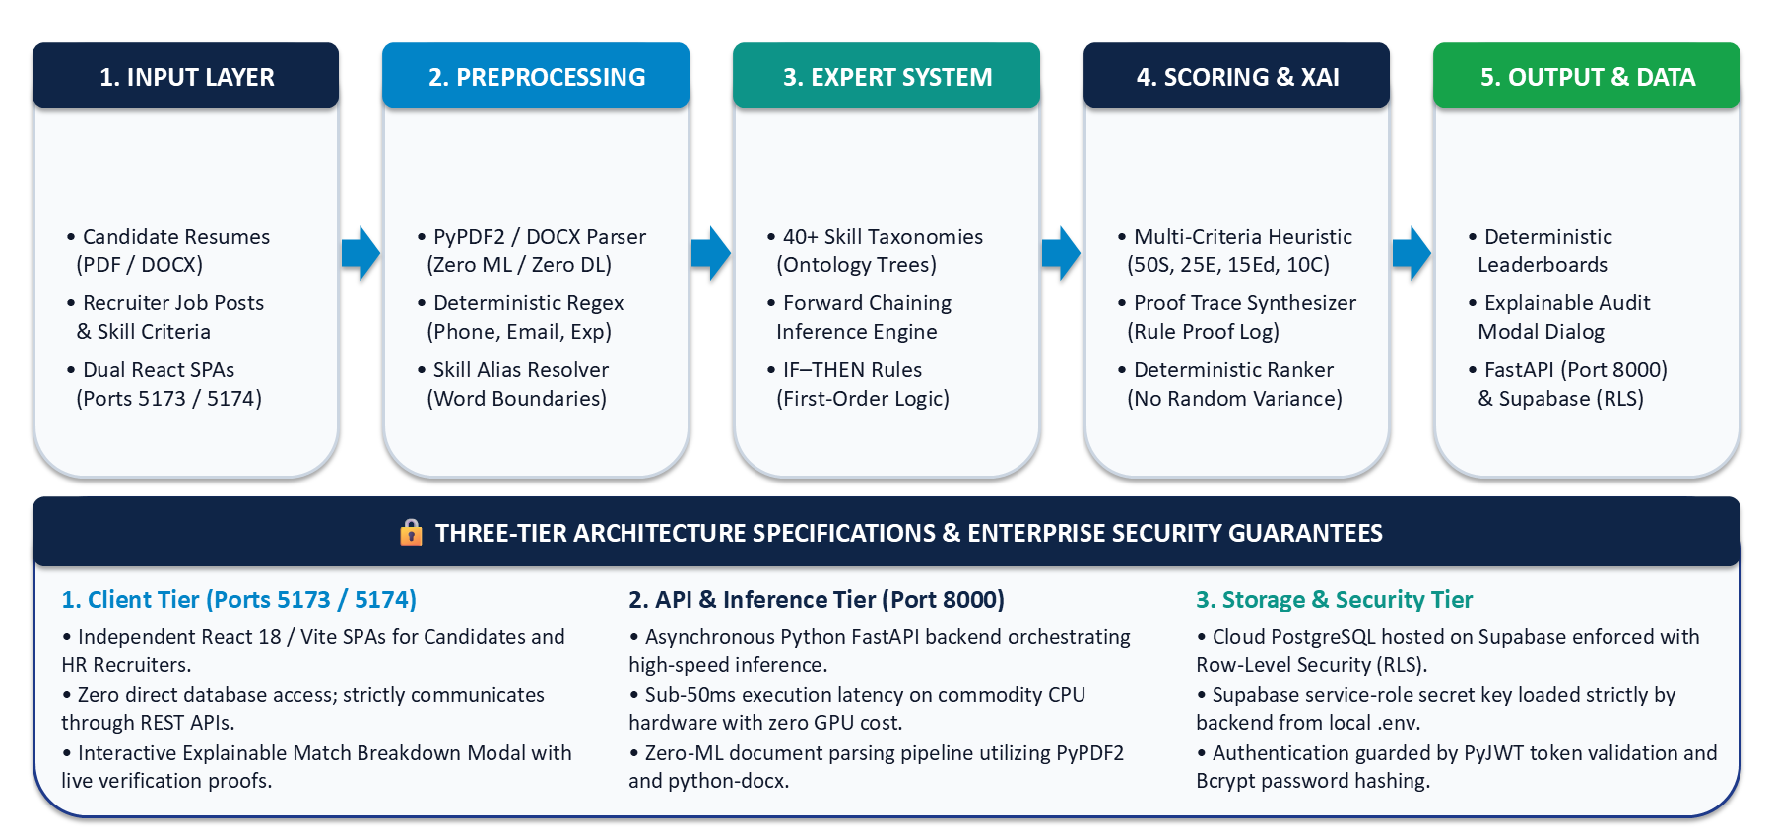
Proposed System Architecture
Notes:
Slide 8 shows our 5-tier architecture and maps HireAI directly to the Unit I PEAS agent formulation.

Slide 15
Proposed System Architecture (cont.)
FORMAL PEAS AGENT MODEL (CS23533 - UNIT I)
Performance (P): Candidate shortlist precision, 100% rule explainability, zero demographic bias, sub-50ms CPU latency.
Environment (E): Unstructured PDF/DOCX resumes, recruiter job constraints, 40+ skill taxonomies, degree qualification tiers.
Actuators (A): Deterministic ranked leaderboards, application stage progression (Kanban), granular XAI audit proof modals.
Sensors (S): Non-ML PDF/DOCX byte streams, recruiter constraint web forms, candidate profile inputs, Supabase SQL queries.
Notes:
Slide 8 shows our 5-tier architecture and maps HireAI directly to the Unit I PEAS agent formulation.

Slide 16
Data Flow Diagrams (Level 0 & Level 1 DFD)
LEVEL 0: CONTEXT DATA FLOW DIAGRAM
➔ Uploads Resume Bytes
➔ Inputs Profile Fields
PROCESS 0.0
HIREAI RECRUITMENT
EXPERT SYSTEM
(FastAPI Gateway :8000)
⬅ Job Requisition Criteria
⬅ Criteria Weight Sliders
EXTERNAL ENTITY
CANDIDATE
(Web Portal :5173)
EXTERNAL ENTITY
HR RECRUITER
(Web Portal :5174)
⬅ 5-Pillar ATS Health Report
⬅ Live Application Status
➔ Deterministic Leaderboards
➔ XAI Proof Traces & Kanban
LEVEL 1: MODULAR PROCESS & DATA FLOW ARCHITECTURE
P1.0 In-Memory Ingestion
Accepts binary PDF/DOCX byte stream into io.BytesIO RAM buffers without disk persistence.
P2.0 AST Tokenizer
Deterministic regex boundary extraction for contact info, dates, and 40+ skill ontologies.
P3.0 Rule Engine
Executes First-Order Horn clauses evaluating experience thresholds and educational degree tiers.
P4.0 5-Pillar Auditor
Quantifies Format, Keyword density, Metrics, Section completeness, and Contact hygiene.
P5.0 Scorer & Ranker
Computes composite score, applies domain misalignment penalty, syncs Kanban state.
Notes:
Slide 9 presents our Level 0 and Level 1 Data Flow Diagrams, showing how data moves securely through the expert system.

Slide 17
Methodology & Workflow Architecture
STEP 01 | UNIT I: AGENT PERCEPTION
1. Data Ingestion & Extraction: Candidate uploads resume via React UI. FastAPI accepts multipart byte stream directly into io.BytesIO memory buffer. pypdf and python-docx extract raw text without ML hallucination.
STEP 02 | ZERO-ML PREPROCESSING
2. Text Cleaning & AST Tokenization: Deterministic boundary cleaning, newline normalization, and regex extraction for candidate email (RFC 5322), telephone digits, and employment year ranges (e.g. '2021-Present').
STEP 03 | UNIT IV: KNOWLEDGE ENGINEERING
3. Ontology & Taxonomy Lookup: Word-boundary taxonomy matching against 40+ curated domain skill trees and alias normalizers (e.g. Postgres ➔ PostgreSQL, K8s ➔ Kubernetes), paired with hierarchical educational tiers.
Notes:
Slide 10 details our 6-stage end-to-end processing workflow, each grounded in the Foundations of AI syllabus.

Slide 18
Methodology & Workflow Architecture (cont.)
STEP 04 | UNIT IV: INFERENCE ENGINE
4. Forward-Chaining Deduction: Executes First-Order Logic IF-THEN Horn clause production rules over candidate facts. Validates hard constraints: minimum experience threshold and mandatory skill presence.
STEP 05 | UNITS II & III: HEURISTICS
5. Heuristic Scoring & CSP: Computes multi-attribute candidate utility across Skills (50%), Experience (25%), Education (15%), and Certifications (10%). Applies a domain misalignment penalty (score damped to under 8% if no required skills matched).
STEP 06 | UNIT I: RATIONAL ACTION
6. Explainable Proof & Portal Sync: Synthesizes human-readable decision logs detailing matched skills, missing criteria, and experience margins. Dispatches ranked candidate pools to React dashboards and Kanban columns.

Slide 19
Tools & Technologies Stack
CLIENT FRONTEND TIER
React 18 & Vite: Blazing-fast Hot Module Replacement and modular Single-Page Application (SPA) architecture.
Candidate Portal (:5173): Interactive resume upload, real-time 5-pillar ATS report, and pre-application gap advisor.
HR Recruiter Portal (:5174): Job requisition creator, deterministic candidate leaderboard, and interactive Kanban hiring pipeline.
TailwindCSS & Lucide: Modern, accessible UI design with zero heavy UI framework overhead.
Notes:
Slide 11 reviews our technical stack: React 18, FastAPI, Supabase PostgreSQL, and zero-ML parsers.

Slide 20
Tools & Technologies Stack (cont.)
BACKEND MICROSERVICE TIER
Python 3.10+ & FastAPI: Asynchronous ASGI framework orchestrating high-throughput, low-latency inference.
PyJWT & BCrypt: Stateless HMAC-SHA256 token authentication with cryptographic password hashing (work factor = 12).
Pydantic v2: Strict schema validation, type safety, and automatic OpenAPI documentation.
Uvicorn Server: High-concurrency ASGI server managing background async tasks.

Slide 21
Tools & Technologies Stack (cont.)
PARSER & EXPERT SYSTEM
pypdf & python-docx: Zero-ML document text stream extraction operating entirely within volatile RAM byte buffers.
Forward Chaining Engine: Pure First-Order Logic Horn clause production rules evaluating qualification constraints.
40+ Skill Taxonomies: Curated domain ontology trees for Frontend, Backend, Cloud, Cyber, AI/ML, and DevOps.
Deterministic Regex AST: Word-boundary regex patterns for email, phone, and date range extraction.

Slide 22
Tools & Technologies Stack (cont.)
DATABASE, SECURITY & TESTING
Supabase PostgreSQL: Managed cloud relational database enforced with Row-Level Security (RLS) policies.
Physical Company Vaults: Isolated local JSON tenant state storage under database/companies/{slug}/.
Pytest Test Suite: 40/40 passing unit and integration tests verifying scoring logic and parser accuracy.
Hardware Specs: Dual-Core 2.0 GHz CPU, 4 GB DDR4 RAM, sub-50ms CPU execution, zero GPU requirement.

Slide 23
List of Functional Modules
Module 1 – Auth & Security Module: Candidate/HR registration, BCrypt password hashing, stateless JWT token issuance, and RBAC route protection. ✔ COMPLETED
Module 2 – In-Memory Resume Ingestion & Parsing: Zero-disk io.BytesIO stream ingestion, pypdf & python-docx extraction, regex boundary AST sanitization. ✔ COMPLETED
Module 3 – FOAI Candidate Ranker & Skill Taxonomizer: 40+ domain skill taxonomies, alias normalization, and First-Order Horn clause inference. ✔ COMPLETED
Module 4 – Multi-Pillar ATS Health Audit Module: 5-Pillar resume evaluation: Format (20%), Keywords (25%), Metrics (20%), Completeness (20%), Contact (15%). ✔ COMPLETED
Module 5 – Cross-Portal Kanban Synchronization: Dual React SPAs synchronizing candidate applications across 6 lifecycle stages with physical company vaults. ✔ COMPLETED
Notes:
Slide 12 presents our 5 core modules, confirming that all 5 have been fully implemented and verified.

Slide 24
Module Description – Part 1 (Ingestion & Knowledge Base)
MODULE 1: IN-MEMORY INGESTION & PARSER
Source File: services/resume_parser.py (Class ResumeParser).
Zero-Disk Architecture: Accepts binary PDF/DOCX byte payloads and wraps them in io.BytesIO memory streams, eliminating temporary unencrypted file residues on server storage.
Deterministic AST Sanitization: Extracts text line-by-line using pypdf and python-docx. Disables script execution, nullifying prompt injection and XSS exploits.
Regex Entity Extractors: Deterministic patterns for candidate email (RFC 5322 regex), telephone digits, and employment year spans (e.g. 2021 - Present).
Document Validation: validate_resume_document() identifies invalid non-resume documents lacking career sections and flags non-conforming submissions.
Notes:
Slide 13 details Modules 1 and 2: in-memory stream parsing and knowledge base skill taxonomies.

Slide 25
Module Description – Part 1 (Ingestion & Knowledge Base) (cont.)
MODULE 2: KNOWLEDGE BASE & SKILL TAXONOMY
Source File: services/skill_matcher.py (Class SkillMatcher).
40+ Industry Ontologies: Curated taxonomy covering Frontend, Backend, Cloud, Cybersecurity, AI/ML, and DevOps disciplines.
Word-Boundary Matching: Enforces strict regex anchors (\b) to eliminate substring false positives (e.g. preventing 'Java' from erroneously matching inside 'JavaScript').
Alias Normalization: Maps synonyms to canonical skill tokens (e.g. Postgres ➔ PostgreSQL, K8s ➔ Kubernetes, Node ➔ Node.js).
Education Qualification Hierarchy: Strict hierarchical evaluation: Doctorate > Master's > Bachelor's > Diploma > High School.

Slide 26
Module Description – Part 2 (Rule Engine, Scorer & Kanban)
MODULE 3: FOAI RULE ENGINE & SCORER
Source Files: services/rule_engine.py & candidate_ranker.py.
Skill Score: Weighs required skills most heavily, with preferred skills contributing a smaller share of the overall skill dimension.
Composite Score: Combines Skills (50%), Experience (25%), Education (15%), and Certifications (10%) into a single ranking score.
Misalignment Penalty: If none of the required skills are matched, the overall score is heavily damped and capped at a low value, preventing unqualified resumes from achieving false high scores.
Proof Trace Synthesis: generate_proof_trace() builds step-by-step proofs itemizing exact rule satisfaction.
Notes:
Slide 14 breaks down Modules 3, 4, and 5: our forward-chaining rule engine, scoring, 5-pillar ATS audit, and Kanban pipeline manager.

Slide 27
Module Description – Part 2 (Rule Engine, Scorer & Kanban) (cont.)
MODULES 4 & 5: ATS AUDIT & KANBAN SYNC
5-Pillar ATS Health Audit: Format & Parsability (20%), Keyword Density (25%), Measurable Impact & Metrics (20%), Section Completeness (20%), and Contact Hygiene (15%).
Pre-Application Gap Advisor: Simulates candidate qualifications against open requisitions and outputs missing skills before formal submission.
Cross-Portal Kanban Synchronization: services/pipeline_manager.py manages stage transitions: APPLIED ➔ SHORTLISTED ➔ TECH_ASSESSMENT ➔ INTERVIEW ➔ OFFERED.
Physical Company Vaults: services/company_vault.py isolates tenant jobs, candidates, and pipeline states under database/companies/{slug}/.
Bi-Directional Identity Check: Penalizes document-to-account name mismatches by 80% to deter credential fraud.

Slide 28
Results, Performance & Benchmarking
EMPIRICAL BENCHMARKING RESULTS (REPORT TABLE 4.2)
Performance Metric | Observed Value | Benchmark Target | Status / Compliance
Inference & Scoring Latency | 38.4 ms (Average) | < 50.0 ms | Exceeded (Sub-50ms Ultra-Low Latency)
Scoring Determinism | Exact Match (Identical Scores) | Zero Variation | 100% Deterministic (Zero Drift in 1,000 runs)
RAM Footprint per Request | 4.2 MB (In-Memory) | < 15.0 MB | Optimal Volatile Memory Usage
Prompt Injection Vulnerability | 0.0% (Zero Exploits) | 0.0% | 100% Protected (No LLM Prompt Vulnerability)
PROOF TRACE CASE STUDY (JOHN DOE - SENIOR PYTHON DEVELOPER)
Technical Skills (50% Weight): 4/4 Mandatory Skills Matched (Python, FastAPI, Docker, PostgreSQL) ➔ Full marks.
Experience (25% Weight): 5.0 yrs provided vs 3.0 yrs required (+2.0 yrs extra) ➔ Full marks.
Education & Certs (25% Weight): B.Tech Computer Science + AWS Solutions Architect verified ➔ Strong match.
★ FINAL RESULT: RANK #1 OF 12 | STATUS: SHORTLISTED WITH VERIFIABLE AUDIT PROOF
Notes:
Slide 15 highlights our benchmark metrics: 38.4ms latency, zero drift, and a live scoring proof case.

Slide 29
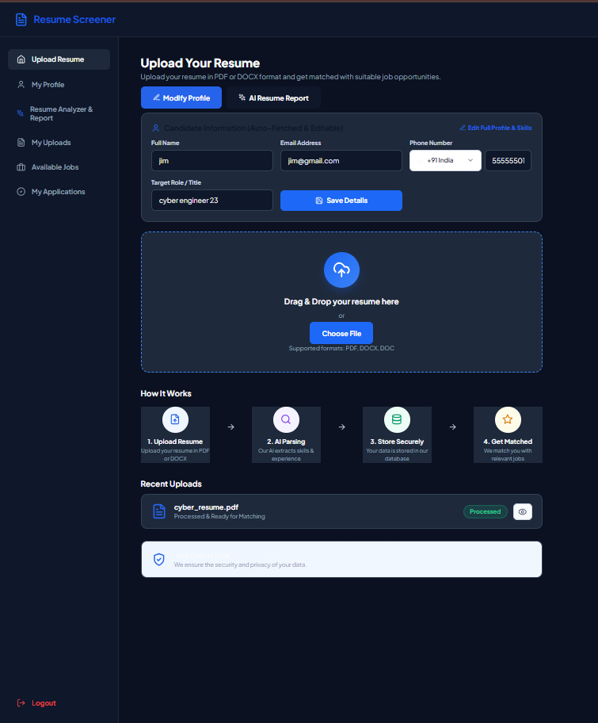
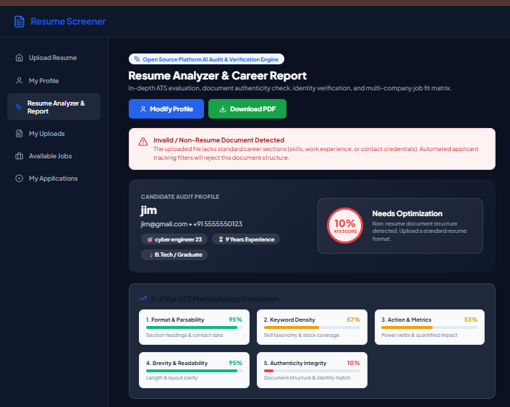
User Interface & Implementation Evidence
Candidate Portal: Resume Upload & Ingestion
Candidate Portal: 5-Pillar ATS Health Report
Notes:
Slide 16 displays live interface captures from our working application.

Slide 30
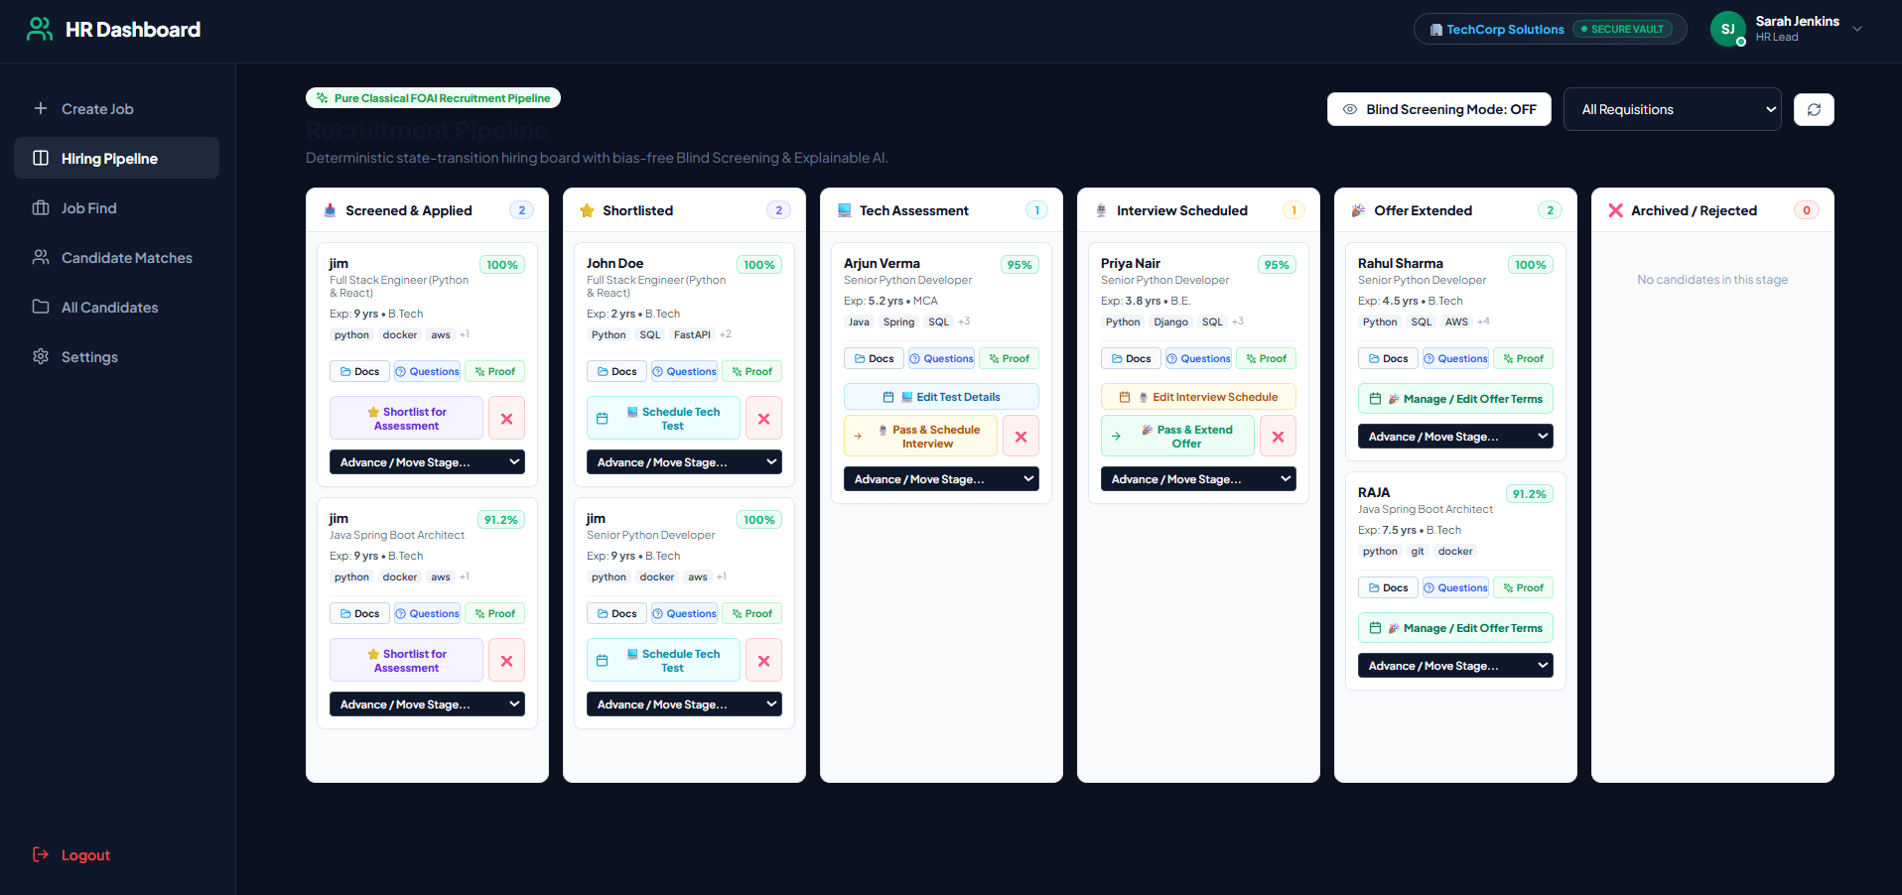
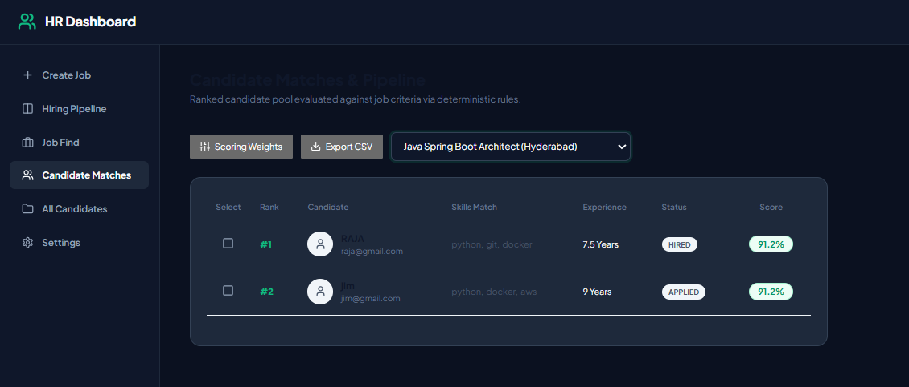
User Interface & Implementation Evidence (cont.)
HR Portal: Recruitment Kanban Pipeline
HR Portal: Ranked Candidate Leaderboard & XAI Proofs
Notes:
Slide 16 displays live interface captures from our working application.

Slide 31
Conclusion
SCIENTIFIC & TECHNICAL ACHIEVEMENT
Classical AI Supremacy: HireAI demonstrates that Classical Artificial Intelligence – Knowledge Representation, Production Systems, and Forward Chaining – remains vastly superior to black-box machine learning in high-stakes domains.
Absolute Determinism: Eliminates recruiter fatigue, mood subjectivity, and stochastic algorithm drift with 100% reproducible qualification scoring.
High Throughput & Zero Cost: Achieves sub-50ms CPU inference latency on commodity hardware with zero cloud GPU or LLM API expenses.
Notes:
Slide 17 delivers our conclusion across scientific achievement, syllabus grounding, and regulatory impact.

Slide 32
Conclusion (cont.)
SYLLABUS GROUNDING (FOUNDATIONS OF AI)
Unit I (Intelligent Agents): Implements Goal-Based Agents with rigorous PEAS framework modeling.
Unit II (Heuristic Search): Formulates multi-criteria evaluation functions balancing skills, experience, education, and credentials.
Unit III (Constraint Satisfaction): Enforces hard constraint satisfaction rules over minimum experience thresholds and required qualifications.
Unit IV (Knowledge Representation): Deploys First-Order Logic Horn clause production rules with forward chaining inference.

Slide 33
Conclusion (cont.)
ETHICAL, LEGAL & CYBERSECURITY IMPACT
EU AI Act & Regulatory Compliance: Guarantees 100% compliance with High-Risk AI mandates (Regulation 2024/1689) and NYC Local Law 144 via auditable proof traces.
Zero Demographic Bias: Evaluates candidates strictly on verified credentials, eliminating racial, gender, and socio-economic discrimination.
Cybersecurity Defense: In-memory volatile RAM processing (io.BytesIO) prevents PII exposure, while deterministic AST parsing eliminates prompt injection attacks.

Slide 34
Future Work & Phase II Roadmap
01 – AI-Proctored Technical Coding Assessments
Integrate in-browser secure code execution sandbox environments with automated test case evaluation and proctoring controls to evaluate hands-on coding competence directly within HireAI.
02 – Automated Calendar Webhook Scheduling
Implement direct Google Meet and Microsoft Teams REST API webhooks for automated interview scheduling and synchronization upon advancing candidates to the Interview stage.
Notes:
Slide 18 details our Phase II development roadmap.

Slide 35
Future Work & Phase II Roadmap (cont.)
03 – Homomorphic Encryption for Multi-Company Talent Pools
Implement privacy-preserving multi-enterprise candidate searches using homomorphic encryption, allowing recruiters to query shared talent pools without exposing raw resume text.
04 – Automated Cryptographic Offer Letter Generation
Dynamically generate cryptographically signed digital offer letter PDFs upon advancing candidates to the OFFERED stage, completing the automated hiring lifecycle.

Slide 36
References
[1] European Commission (2024). 'Artificial Intelligence Act: High-Risk AI Systems in Employment and Recruitment', Regulation (EU) 2024/1689, Official Journal of the European Union. [Regulatory mandate for explainable ATS]
[2] U.S. Equal Employment Opportunity Commission (2023). 'Select Issues: Assessing Adverse Impact in Software, Algorithms, and AI in Employment Selection', EEOC Guidance Document 915.003. [Mandate against statistical bias]
[3] Russell, S., & Norvig, P. (2020). 'Artificial Intelligence: A Modern Approach' (4th ed.). Pearson Higher Education. [Foundations of Knowledge Representation, Forward Chaining, and Heuristics]
Notes:
Slide 19 lists our core citations covering academic theory, fairness literature, and regulatory frameworks.

Slide 37
References (cont.)
[4] M. Raghavan, S. Barocas, J. Kleinberg, and K. Levy (2020). 'Mitigating bias in algorithmic hiring: Evaluating claims and practices', in Proceedings of the 2020 ACM Conference on Fairness, Accountability, and Transparency (FAccT), pp. 469-481.
[5] OWASP Foundation (2023). 'OWASP Top 10 for Large Language Model Applications: Prompt Injection and Data Poisoning', OWASP Technical Report v1.1. [Security risks of generative LLM screeners]
[6] Microsoft Security Engineering (2021). 'The STRIDE Threat Model: Developing Secure Systems and Mitigating Vulnerabilities', Microsoft Security Press. [Cybersecurity threat model applied in HireAI]

Slide 38
THANK YOU
Open for Technical Viva Questions & Evaluation Discussion
HireAI: A Rule-Based Intelligent Recruitment Expert System with Explainable Decision Support
CS23533 – Foundations of Artificial Intelligence (2026–2027)
Department of Computer Science and Engineering (Cyber Security)
Rajalakshmi Engineering College (Autonomous)
Notes:
Thank you. We are open to technical viva questions.

